Slide 1
US Companies
Revenue Prediction
Try to predict Revenue' future performance leveraging 200+ financial indicators

Slide 2
Overview
Used the Dataset from kaggle
Is it possible to have a machine learning model to predict Revenue ?
Some financial indicator values are missing (nan cells), so the used the best technique to clean each dataset (dropna, fillna, etc.).
Leverage this knowledge in order to predict which stock will be worth buying?

Slide 3
Dataset - Columns
Company Name
Revenue
R&D Expenses
Operating Income
Interest Expense
Weighted Average Shs Out
Goodwill and Intangible Assets
Tax assets
Payables
Long-term debt
Deferred revenue
Retained earnings (deficit)
Operating Cash Flow
Pperating Profit Margin
Sector
Notes:
not

Slide 4
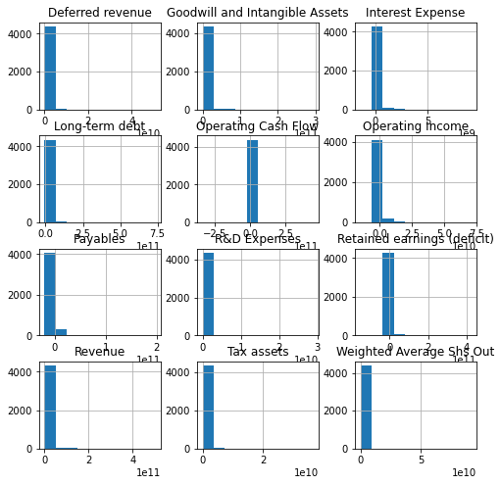
Data Visualization
Taking a look at the distribution:
Non of the data is normally distributed
There are a lot more 0 values than 1 for most of the binary features

Slide 5
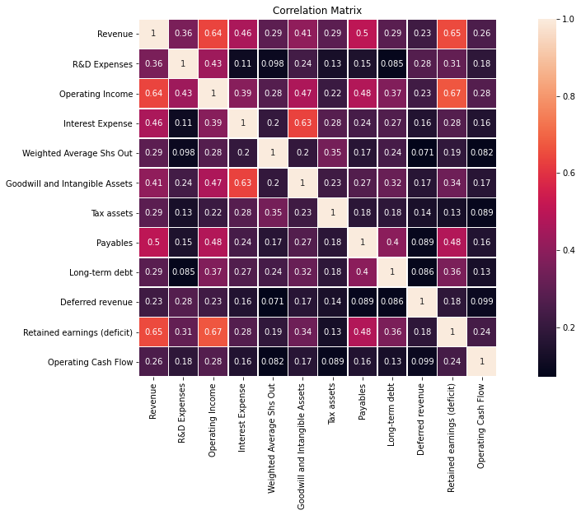
Data Visualization cont.
Taking a look at correlation features:
do not have that high of correlation

Slide 6
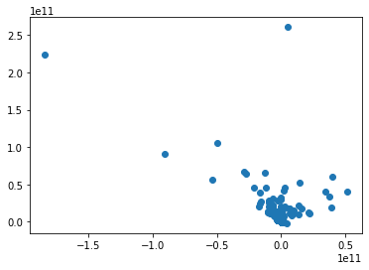
Linear Regression
The number of observations in training set is 3952
The number of observations in test set is 440
Coefficients:
[ 3.01475051e+00 1.92210767e+00 1.19833680e+01 1.08922244e+00
1.98324254e-01 -1.46424350e+09 -1.38718469e+09 -1.20072590e+09
4.05215408e+09]
Intercept: 1271235313.28087
R-squared score of test set: 0.5141844713922562
R-squared score of training set: 0.5305466728679824
Root mean squared of test set: 12018725434.431017
Root mean squared of training set: 14186583488.938942
Lasso R2= 0.5141844713754264
12018725434.639194 Regularization

Slide 7
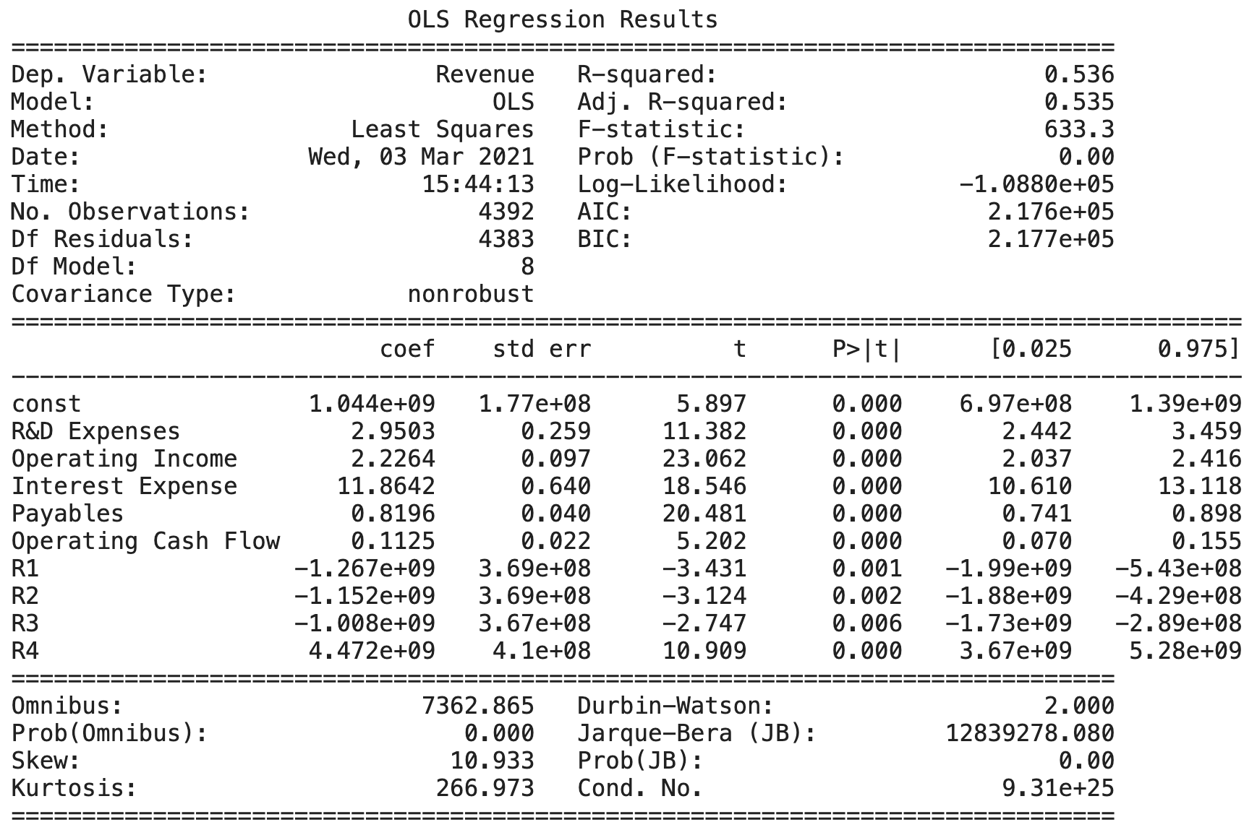
OLS Regression Results

Slide 8
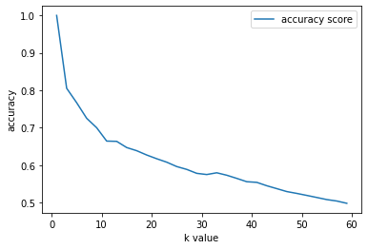
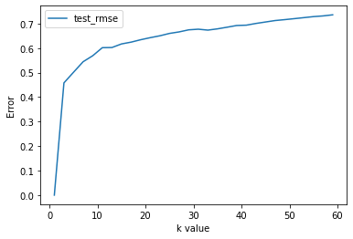
KNN
K-Value range (1,61,2)
Turned the train data for hyperparameter
Root MSE = 61%

Slide 9
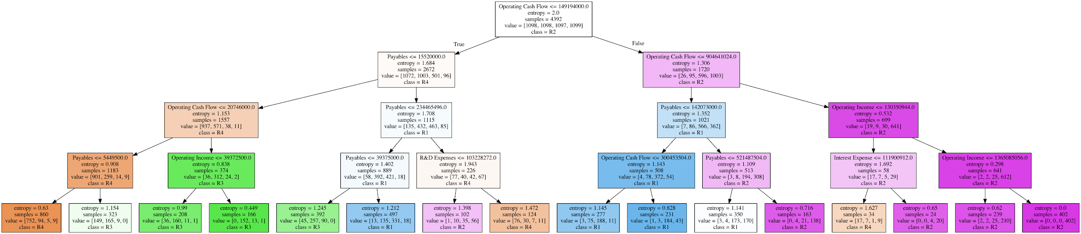
Decision Tree

Slide 10
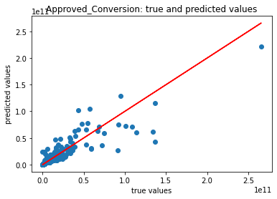
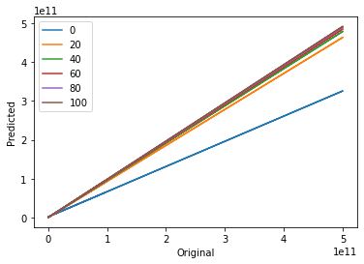
Random Forest Regression
Weak learner 0 R2: -2.017810747003405
Weak learner 20 R2: -0.018655524269844515
Weak learner 40 R2: -0.02414608098550164
Weak learner 60 R2: -0.013345935639234918
Weak learner 80 R2: -0.026052536508854862
Weak learner 100 R2: -0.007127490439781781
Overall R2 :0.9940147637179528

Slide 11
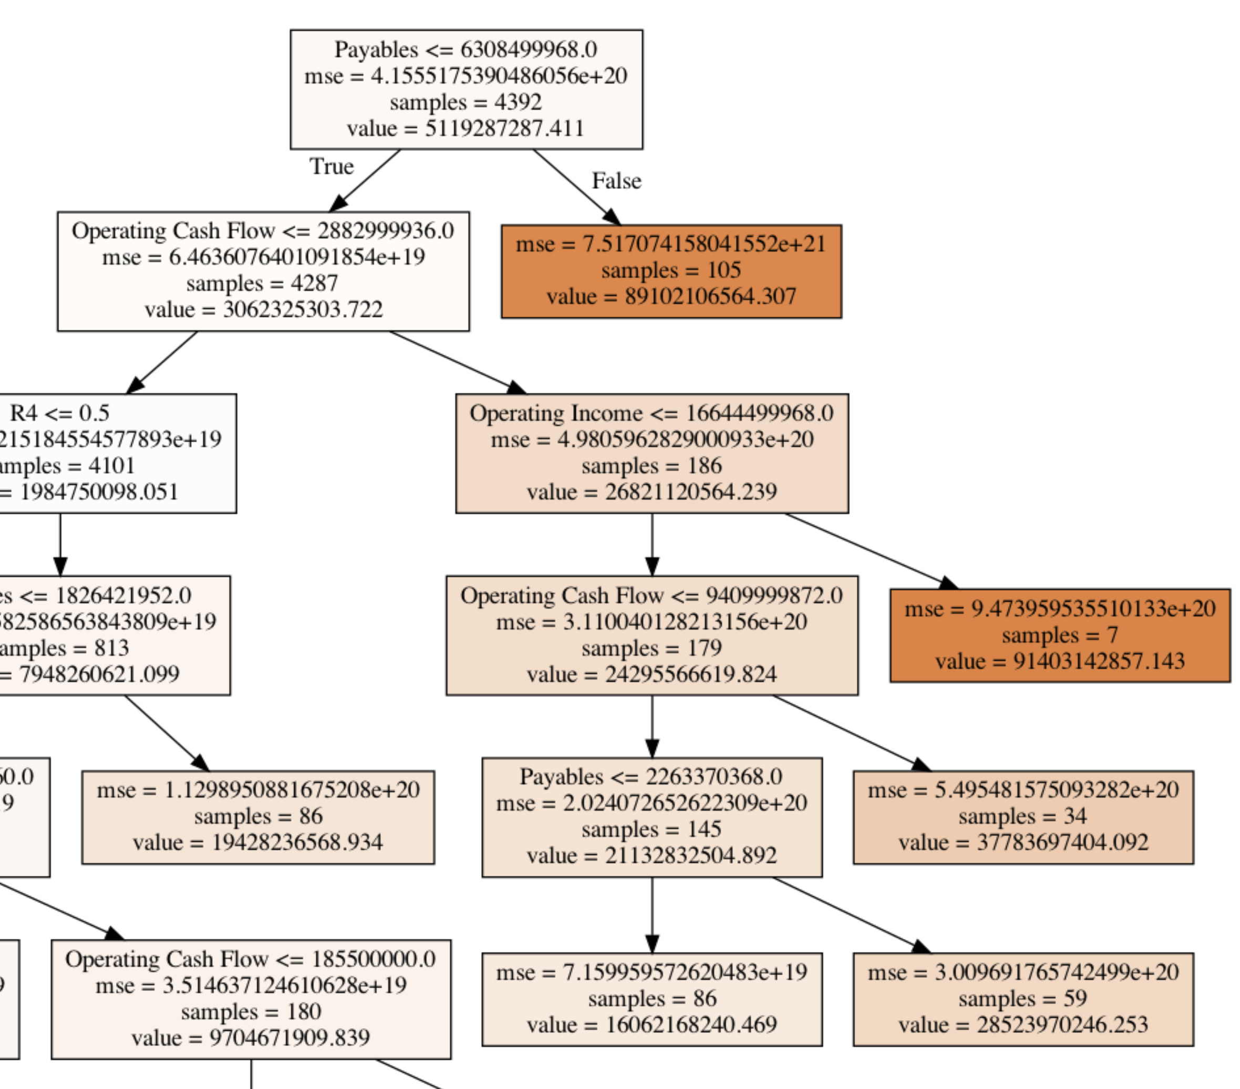
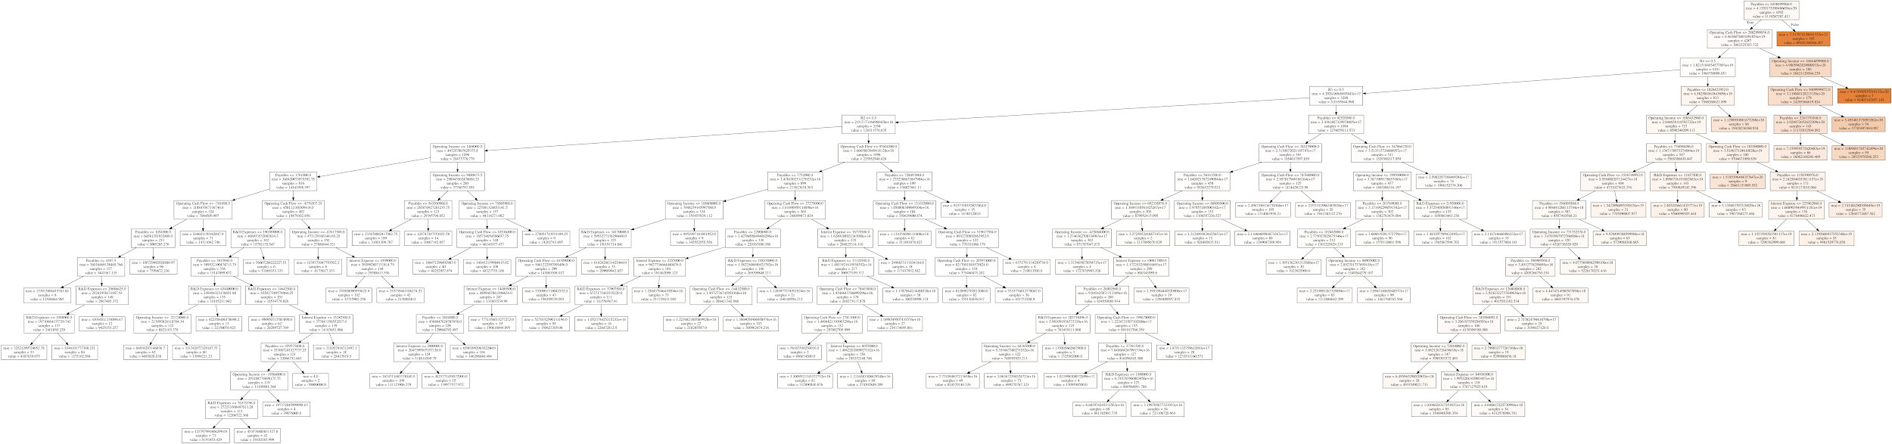
Decision Tree
One strongish learner R^2: 0.5303754584922729

Slide 12
Future analysis consideration
Explore, more hyperparameters and parameters of each model ( by cross validation method), and possibly incorporate another model
Support vector machine (SVM) and logistic regression
To get more accurate and balanced readings, standardizing the distribution of popularity score would help
Can potentially achieve a better accuracy score as well as find some interesting trends

Slide 13
Thank You
Any Questions!

